Slide 1
SEL Intern Presentation: Summer 2015
By: Tyler Cruz
Software Engineer Intern

Slide 2


Tyler, who are you?
10100100010001110110001110101011010010001000111011000111010101
10100100010001110110001110101011010010001000111011000111010101
10100100010001110110001110101011010010001000111011000111010101
10100100010001110110001110101011010010001000111011000111010101
10100100010001110110001110101011010010001000111011000111010101
10100100010001110110001110101011010010001000111011000111010101
10100100010001110110001110101011010010001000111011000111010101
The intern that works for Matt,
A computer science major,
A person who loves sports and coding,
A Marylander,
And a Coug!
10100100010001110110001110101011010010001000111011000111010101
10100100010001110110001110101011010010001000111011000111010101
10100100010001110110001110101011010010001000111011000111010101
10100100010001110110001110101011010010001000111011000111010101

Slide 3
Tyler, the most interesting thing you’ve learned?
RESTful Web APIs

Slide 4
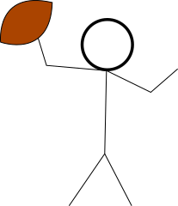

RESTful Web APIs
Many of the websites you know and love offer RESTful Web Services, including Facebook, Twitter, PayPal, JitBit and Jira - just to name a few.
These APIs allow us to read/write data using HTTP protocol from/to these servers in order to make our programs’ wildest dreams come true.
My program (client)
RESTful Web API (server)
Notes:
Use = read/write
Access to info of trillions of tweets

Slide 5
RESTful Web APIs
HTTP Protocol: The same language that our browsers use to request the web pages that we request!
My program (client)
RESTful Web API (server)
Notes:
With RESTful Web APIs client server communication
http messages
http messages are http requests and response
That’s the same standard of communication that our browsers use to request the beautiful web pages that we request from servers all over the world - everyday! HTTP messages include http

Slide 6
RESTful Web APIs
The REQUEST
A message to the web API using HTTP protocol
My program (client)
RESTful Web API (server)

Slide 7

The HTTP Request
What can we request?
We can request:
Data from the server (GET)
To Update something on server (PUT)
To Post something to server (POST)
To Delete from server (DELETE)
Notes:
In this case our Http request will be this football http protocol ball
Get = could query or search for some info on the database

Slide 8
HTTP Request to JitBit’s RESTful API
A request may contain other information, like username and password to ensure the ‘requester’ has permission to request their request.
GET /ticket?id=10
Notes:
Explain green: base of ticket We include information like this in the headers of the Request. There a tons of fields that can be used in the header of HTTP
Request line: url (request) use params to determine which what info u want
Status line: status code (response)
Headers
Body/ optional

Slide 9
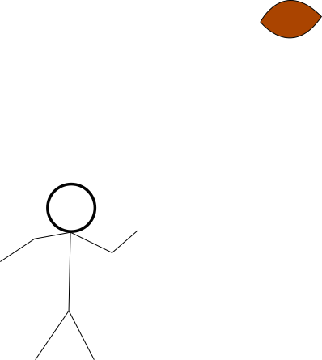
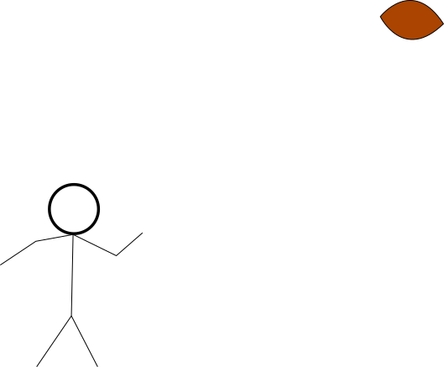

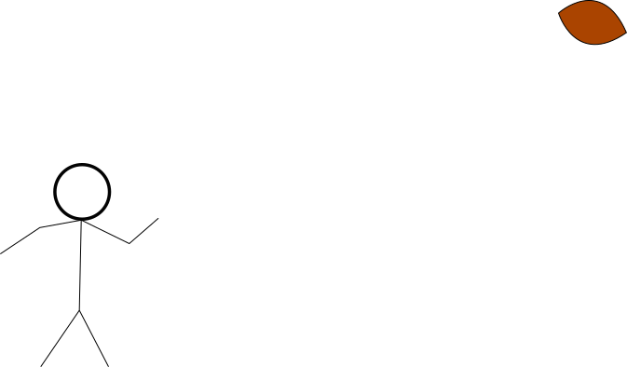




Someone get me the info for a ticket with id 10, pronto!
GET /ticket?id=10
My program (client)
RESTful Web API (server)
RESTful Web APIs

Slide 10

We can’t find ticket #10, boss!!!

Slide 11
The RESPONSE
A message to client (HTTP)
My program (client)
RESTful Web API (server)

Slide 12
The HTTP Response
What’s in the response?
JSON DATA
XAML
HTML pages
Images
Et cetera…
And a Response code!
200s = SUCCESS
400s = NOT FOUND (404)
Notes:
So instead of the server going up in flames when it can’t find our desired resource, we return a 404 status code. That’s why we see 404 when a page is not found

Slide 13
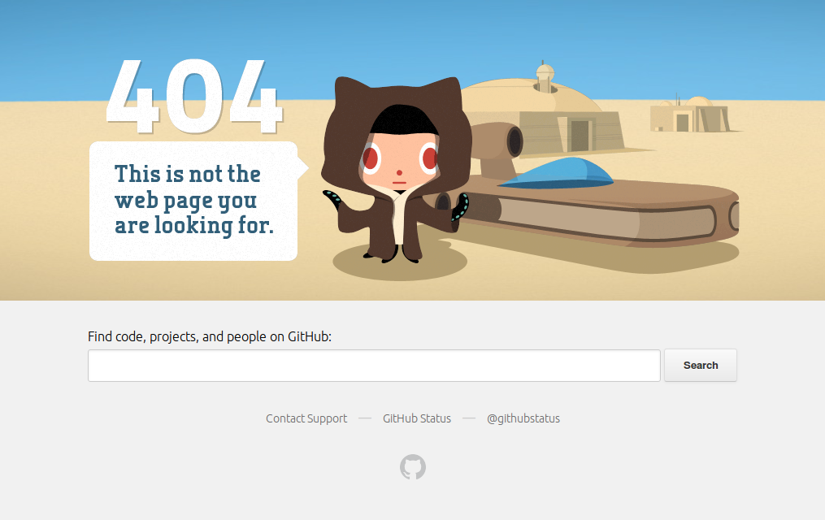



smh…
Notes:
404 error pages, usually when we try to access something on a web server that can not be found

Slide 14
Notes:
Instead of the server burning to the ground because of a bad request

Slide 15
The RESPONSE
A message to client
My program (client)
RESTful Web API (server)

Slide 16
Looks like there is no ticket 10.
404
My program (client)
RESTful Web API (server)
RESTful Web APIs

Slide 17
GET /ticket?id=9
Someone get me the info for ticket with id 9, pronto!
Let’s try ticket 9
GET /ticket?id=9
My program (client)
RESTful Web API (server)
RESTful Web APIs
Notes:
getTicket vs ticket

Slide 18
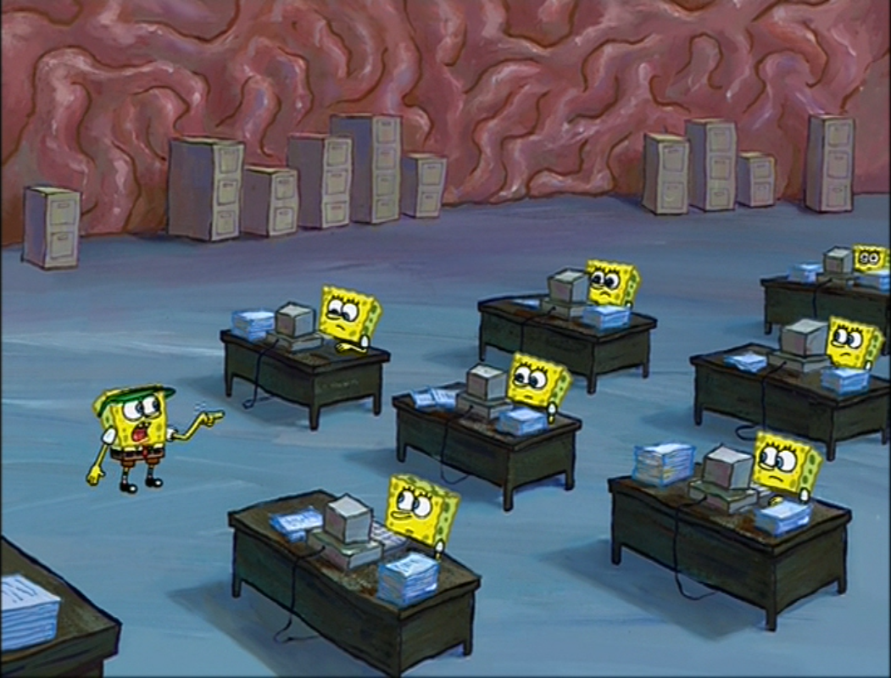
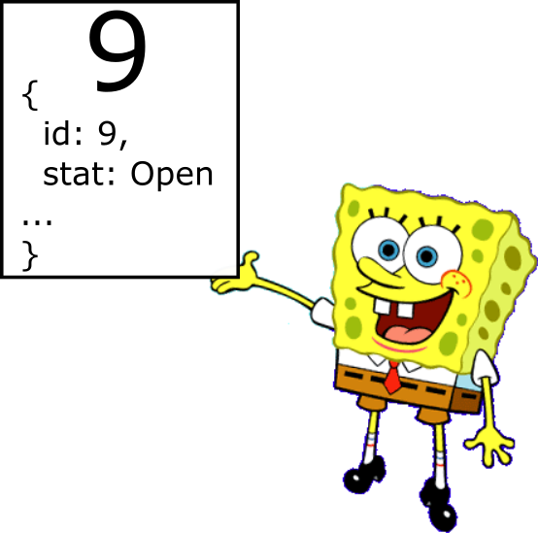
Found it, boss!!!
Notes:
Instead of the server burning to the ground because of a bad request

Slide 19
TICKET 9 request SUCCESS. I have all the information on ticket 9!
200
200
200
My program (client)
RESTful Web API (server)
RESTful Web APIs

Slide 20
HTTP Response from JitBit’s RESTful API
status: 200
Header:
Content-type: JSON,
Server: Apache/3.0
Body: {
id: 9,
tech: “Chase Guyer”,
status: “In progress”
}
Notes:
So instead of the server going up in flames when it can’t find our desired resource, we return a 404 status code. That’s why we see 404 when a page is not found

Slide 21
Thank you

